Slide 1

Daily Review
In the stimulus-response model:
Receptors stimulate the sensory nerves.
The sensory nerves transmit a message to the brain.
The brain works out the response that is required, then sends a message to create a response from the body.
Describing Stimulus-Response
State the stimulus. State the sense organ / receptor. Describe the response.
Trevor leaves a movie theatre and walks onto the sunny street outside. On your whiteboards, describe the stimulus-response in this situation.

Slide 2
Daily Review
A stimulus is any information that the body receives, causing a response, e.g. a hot day or low blood sugar.
A receptor is a structure that detects a stimulus or change in the normal functioning of the body, and sends information to the brain.
Match the following sense organs with the stimulus that the receptors detect.
1. Eye A Pain, pressure, heat, cold
2. Ear B Light and movement
3. Nose C Chemicals in food
4. Tongue D Chemicals in the air
5. Skin E Vibrations in air particles

Slide 3
The Nervous System Year 9 Biology

Slide 4
Learning Objectives
CFU
What are we going to learn?
Describe the function of the nervous system.
Identify parts of the central and peripheral nervous systems.
Identify parts of the brain and their function.
Activate Prior Knowledge
Humans are constantly receiving stimuli from their environment. Our bodies then respond in certain ways.
Think, Pair, Share:
List three different stimuli that your body responded to before you arrived at school this morning.
Vocabulary
stimulus (plural: stimuli) noun something that causes part of the body to respond

Slide 5
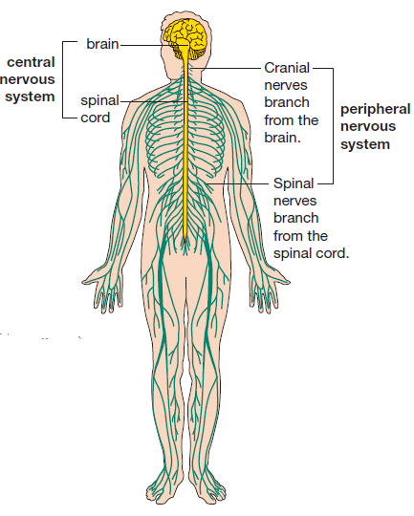
Concept Development
CFU 1
What the role of the nervous system?
The Nervous System
The nervous system is a communication system that controls all parts of the body.
The human nervous system has two main parts:
Central Nervous System, composed of the brain and spinal cord.
Peripheral Nervous System, composed of nerves in the limbs and organs.
CFU 2
What two main parts is the nervous system divided into?
CFU 3
Think, Pair, Share: How would information from touch receptors in the toes reach the brain?

Slide 6
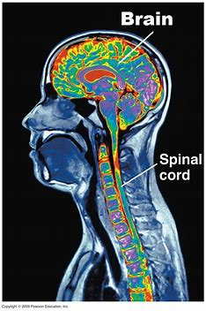
Concept Development
CFU 1
Which two structures make up the CNS?
Central Nervous System
The central nervous system (CNS) is the control centre of the body.
It consists of the brain and spinal cord.
The CNS receives information from all over the body, processes that information, and sends out messages telling the body how to respond.
CFU 2
What is one function of the CNS?

Slide 7
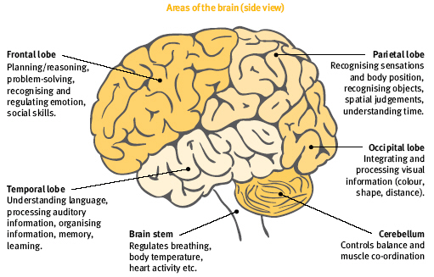
Concept Development
CFU 1
What is the function of the brain?
The Brain
The brain processes internal and external information for the body.
It makes decisions about things such as movements and internal changes.
It also processes thoughts, memories, and emotions.

Slide 8
Concept Development
CFU 1
What are the three main parts of the brain?
CFU 2
How many lobes are in the cerebellum?
CFU 3
Tell the person next to you: two functions of the frontal lobe.
The Brain
The brain is divided into three parts: the cerebrum, cerebellum, and brain stem.
The cerebrum contains four lobes:
Frontal lobe
Temporal lobe
Parietal lobe
Occipital lobe

Slide 9
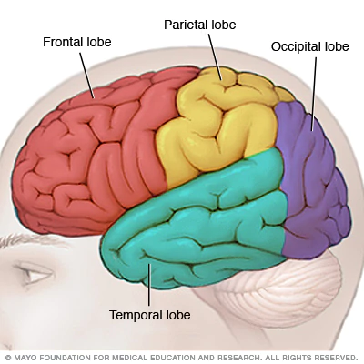

Concept Development
CFU 1
Think, Pair, Share: What could be some side effects of frontal lobe damage?
The Brain – Frontal Lobe
The frontal lobe is located at the front of the brain.
Its functions include reasoning, emotions, movement, and problem solving.

Slide 10

Concept Development
CFU
For which senses does the temporal lobe not receive information?
The Brain – Temporal Lobe
The temporal lobe is located at the sides of the brain.
Its functions include interpreting, organising, and remembering information. This includes understanding language, processing smells, and recognising faces.

Slide 11
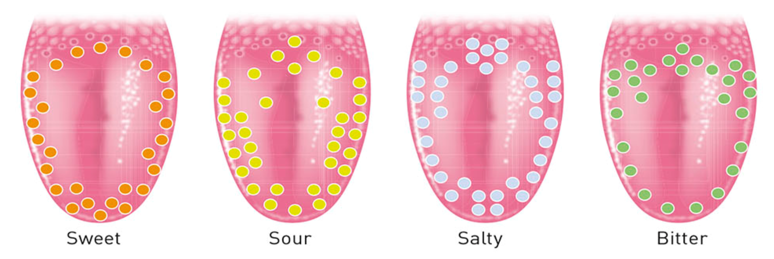
Concept Development
CFU 1
Which sensory organs send information to the parietal lobe?
The Brain – Parietal Lobe
The parietal lobe is located at the top of the brain.
Its functions include perception of taste, pain, temperature, and touch. It also provides spatial awareness (knowing where your body is and how it relates to the outside world).

Slide 12
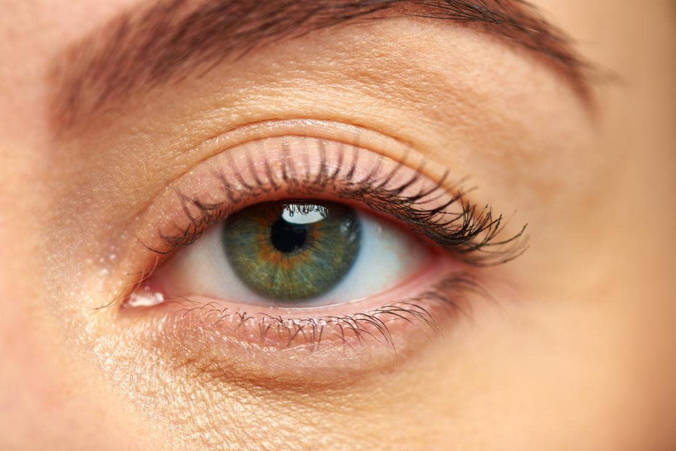
Concept Development
CFU 1
Think, Pair, Share: If you slipped and hit the back of your head, why might everything go black?
The Brain – Occipital Lobe
The occipital lobe is located at the back of the brain.
Its functions include perception of vision. It establishes the distance, depth, location and identity of the objects you see.
Notes:
Ox-sip-i-tal

Slide 13

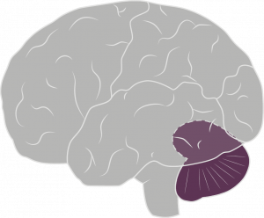
Concept Development
CFU 1
What is the cerebellum responsible for?
The Brain – Cerebellum
The cerebellum is at the base of the cerebrum.
The cerebellum controls coordination and balance.
Without it, standing and walking would be impossible.

Slide 14
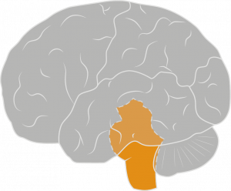
Concept Development
CFU 1
Where is the brain stem located?
The Brain – Brain Stem
The brain stem is at the base of the brain, and connects to the spinal cord.
The brain stem controls the body’s vital functions, such as breathing, blood pressure and heart rate.
CFU 2
What is connected to the brain stem?
CFU 3
Think, Pair, Share: Do we have voluntary control of our body’s vital functions?

Slide 15
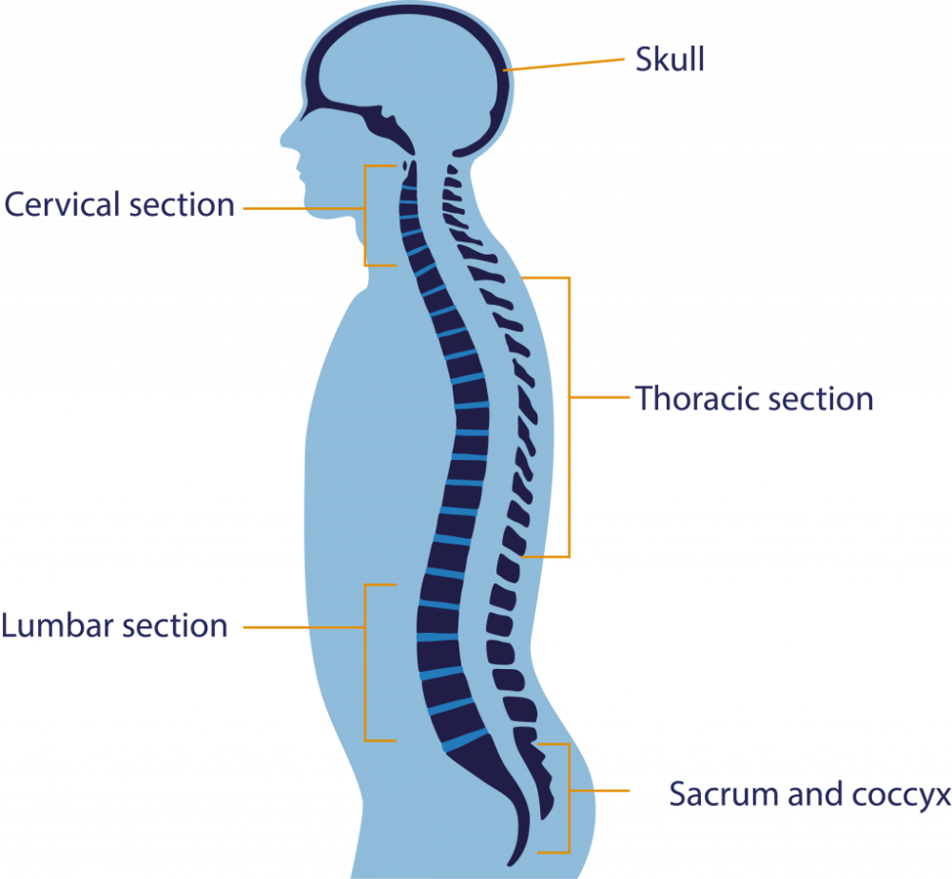
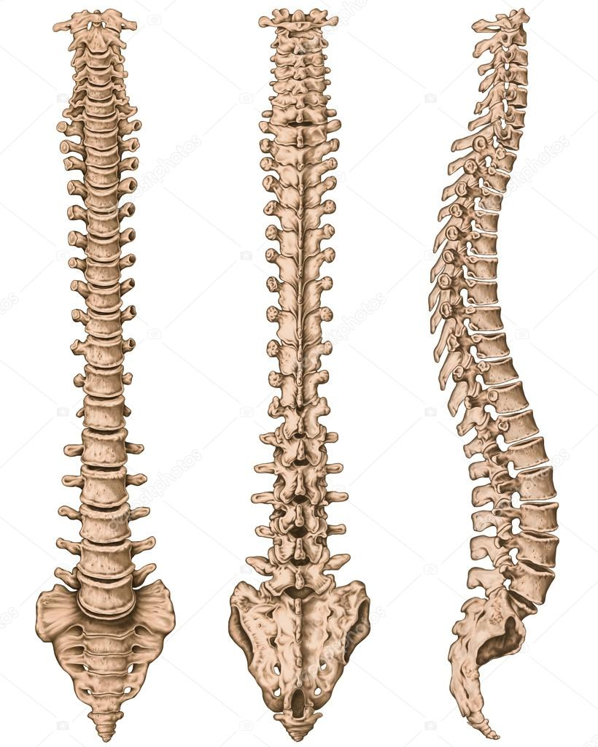
Concept Development
CFU 1
What are the bones of the spine called?
The Spinal Cord
The spinal cord links the brain and the nerves of the Peripheral Nervous System.
It is protected by the bones of the spinal column (spine), called vertebrae.
CFU 2
Think, Pair, Share: What is an effect of damage to the spine?

Slide 16
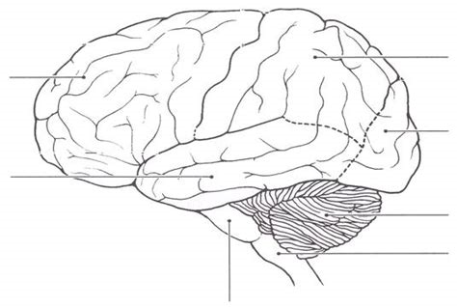
Skill Development
On your brain diagram, label the frontal lobe.
Write what the frontal lobe controls beside or underneath your label.
Frontal Lobe
Reasoning, emotions, movement, problem solving

Slide 17
Skill Development
On your brain diagram, label the temporal lobe.
Write what the temporal lobe controls beside or underneath your label.
Frontal Lobe
Reasoning, emotions, movement, problem solving
Temporal Lobe
Processing information (sounds, language, smells, faces)

Slide 18
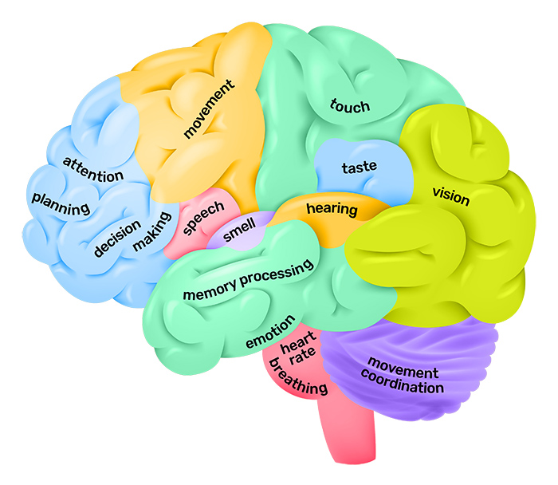
Relevance
Our bodies are complex organisms that are constantly interpreting external and internal information.
Knowing about the structure and function of the brain will help you understand how our body coordinates its movement and internal environment to help us to survive.

Slide 19
Skill Closure
What is the function of the nervous system?
Skill Closure
Explain one difference between the central and peripheral nervous systems.
Skill Closure
Draw a rough sketch of the brain and label the four lobes.
Frontal, Occipital, Temporal, Parietal

Slide 20
Independent Practice
Use the information below to complete your brain diagram.
Add an appropriate title to your page and then colour the lobes of the brain.
Parietal Lobe
At the top of the brain
Taste, pain, temperature, touch, spatial awareness
Occipital Lobe
At the back of the brain
Perception of vision (distance, depth, location, identity of objects)
Cerebellum
At the base of the cerebrum
Coordination and balance
Spinal Cord
Links the brain and the nerves of the Peripheral Nervous System
Brain Stem
At the base of the brain; connects to the spinal cord
Vital functions (breathing, blood pressure, heart rate)
Temporal Lobe
At the sides of the brain
Processing information (sounds, language, smells, faces)
Frontal Lobe
At the front of the brain
Reasoning, emotions, movement, problem solving
Marigold
Trumpet Vine

